Slide 1
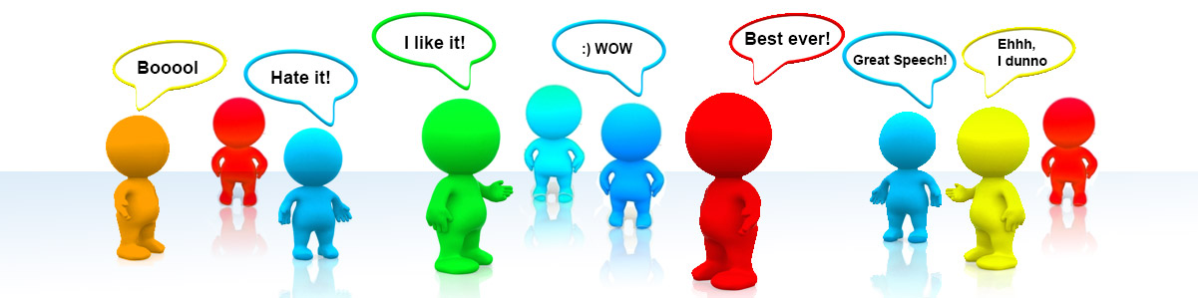
Machines and Sentiments

Slide 2
Introduction

Slide 3
Why Natural Language Processing?
Human Beings are considered as one of the most advanced and successfull species in the world due to their ability to communicate.
This is where the concept of Language comes into the picture, which is nothing but a medium for communication.
So, we have covered the process of communicating with other fellow humans. What about machines? Is it possible to Communicate with the machines in a similar fashion.
Yesss! And here is where NLP comes into the Picture

Slide 4
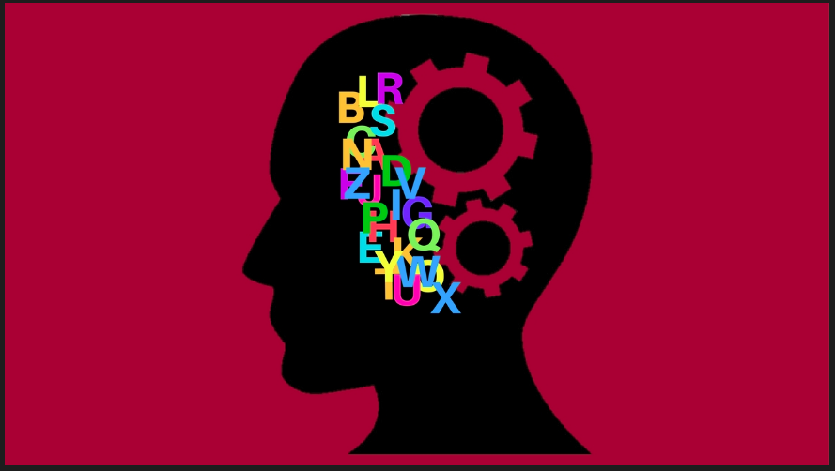
What is Natural Language Processing?
NLP is the process through which the computer/ machine tries to understand and implement the Human language using Large amounts of Natural Language Data.

Slide 5
What is Sentimental Analysis?
As the world progresses exponentially in terms of technological advancements, one of the most essential things which needs to be given importance is Human Sentiments.
Here is where the concept of Sentimental Analysis comes into play where machines identify the underlying sentiments or subjective informaition from the text data which is given.
Sentimental Analysis is also referred to as Opinion Mining. It is a subset of NLP.

Slide 6
Our Project

Slide 7

Project Idea
COVID-19 and Lockdown has pushed up internet usage by a whopping 70% and Online Streaming by 12%.
To help and guide the people, we have built a simple Movie Recommender System and Movie Review Analyser.

Slide 8
Project Concept
We have divided the concept into 3 parts:
Review Analyser:
Analyse and Predict the emotion and nature of a user review using Sentiment Analysis
Movie Recommender System
Recommend a set of Movies based on the Movie which the user inputs.
ROBO
Our very own chatobot which is like the glue of our projects. It not only helps in assisting the user but also integrate both the recommender and review analyser together

Slide 9
Visuals of Our Project

Slide 10
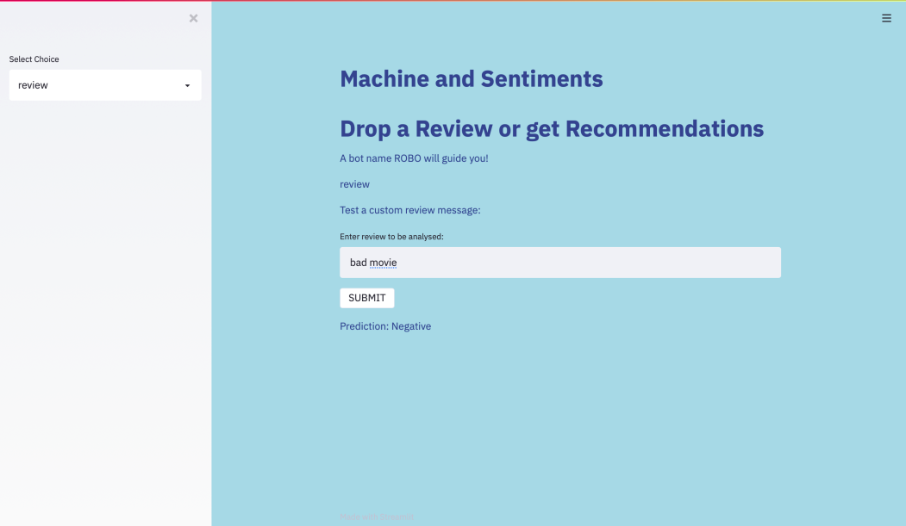
Visuals: Review Analyser

Slide 11
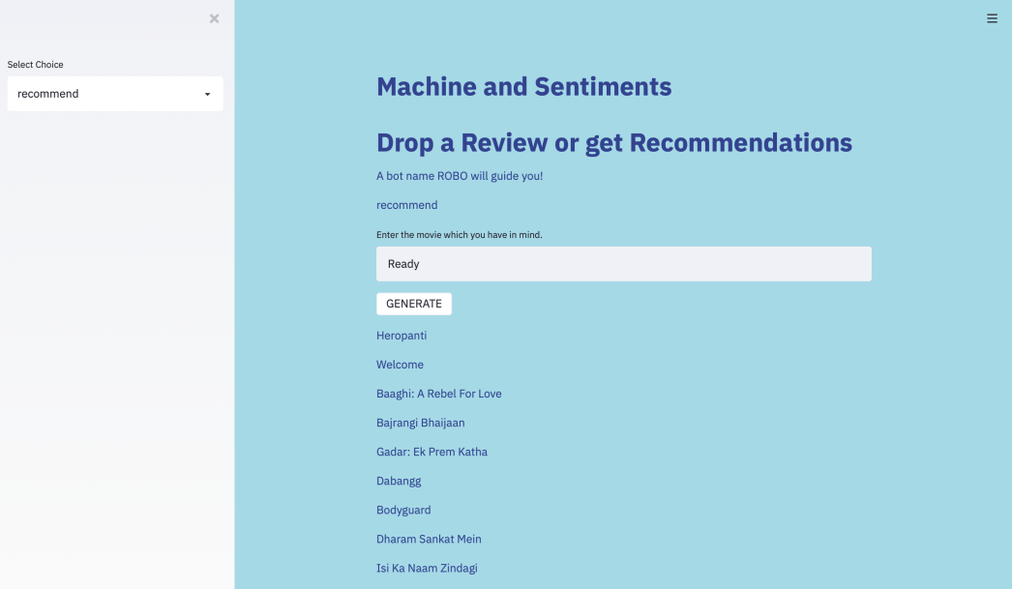
Visuals: Recommender System

Slide 12
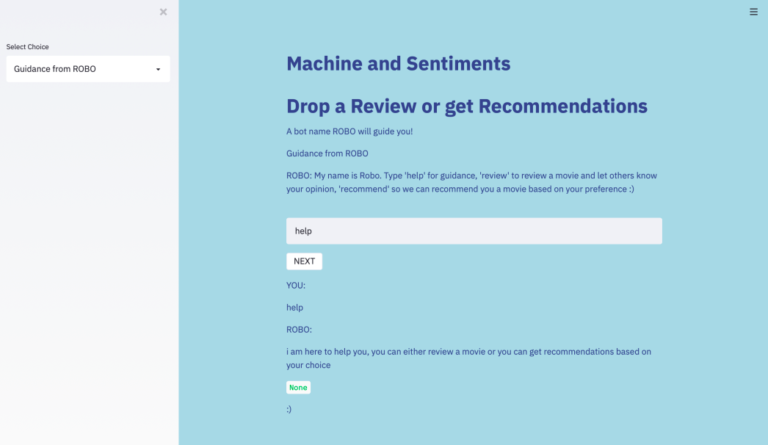
Visuals: Working of the Chatbot

Slide 13
Done By: Saisha Shetty Rusali Saha Pranav B Kashyap

